Slide 1

CMC GLOBAL
java
Spring
Batch
Tutorials
01.

Slide 2
Table
of contents
1
2
Overview
Architecture
Spring batch
3
4
Demo
Reference
02.

Slide 3
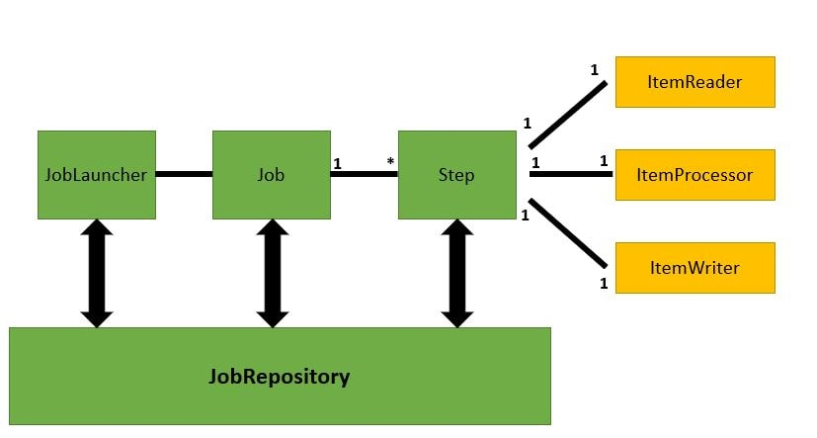
Overview
Definition
Main Architecture
A lightweight, comprehensive batch framework designed to enable the development of robust batch applications vital for the daily operations of enterprise systems.
Pros
Spring Batch provides reusable functions that are essential in processing large volumes of records, including logging/tracing, transaction management, job processing statistics, job restart, skip, and resource management. It also provides more advanced technical services and features that will enable extremely high-volume and high performance batch jobs through optimization and partitioning techniques. Simple as well as complex, high-volume batch jobs can leverage the framework in a highly scalable manner to process significant volumes of information.
11.

Slide 4
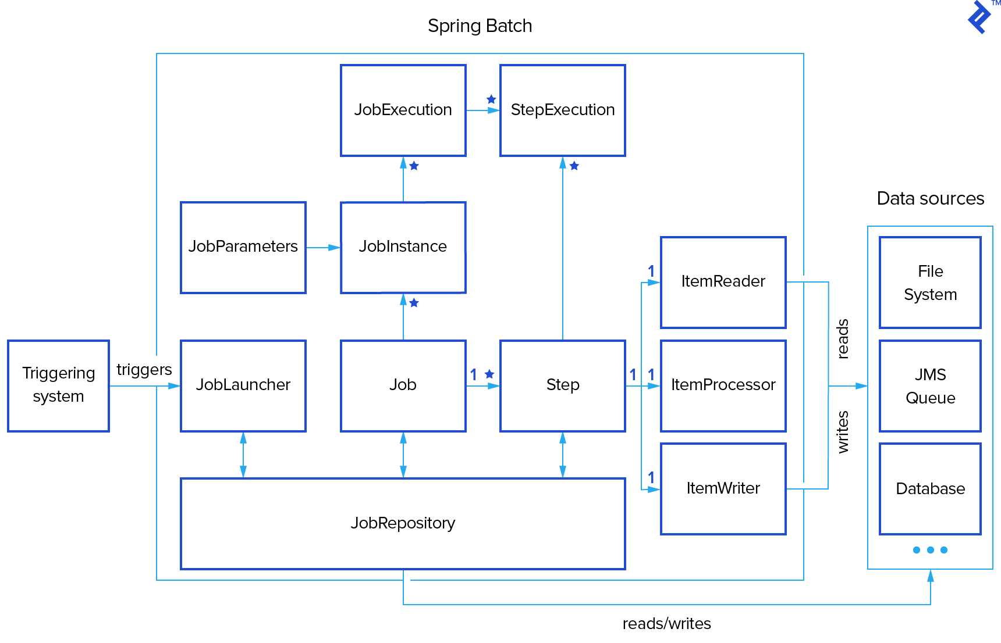
2. Architecture
09.

Slide 5
Spring batch core
1
2
JobRepository
JobLauncher
The mechanism in Spring Batch that makes all this persistence possible. It provides CRUD operations for JobLauncher, Job, and Step instantiations
An interface to execute Job
3
4
Job
Step
Run step
typically has a single ItemReader, ItemProcessor, and ItemWriter
09.

Slide 6
1
2
Job features
JobInstance
JobParameters
Each Job may be associated with multiple JobInstances, each of which is defined uniquely by its particular JobParameters that are used to start a batch job
Parameter of JobInstance
3
4
JobExecution
StepExecution
typically tracks what happened during a run, such as current and exit statuses, start and end times, etc.
stores the information about current and exit statuses, start and end times, and so on, as well as references to its corresponding Step and JobExecution instances.
09.

Slide 7
Step features
1
2
ItemReader
Chunk is complete
ItemProcessor
ItemReader will read the data from csv, xml, kafka, database..... If the number of objects it got are equal to the chunk, the ItemProcessor will proceed, if not, ItemReader will continue reading new data.
It gets data from ItemReader then proceed business and send to ItemWriter.
3
Data
source
ItemWriter
It will write the data to database, csv, xml or kafka topic......
09.

Slide 8
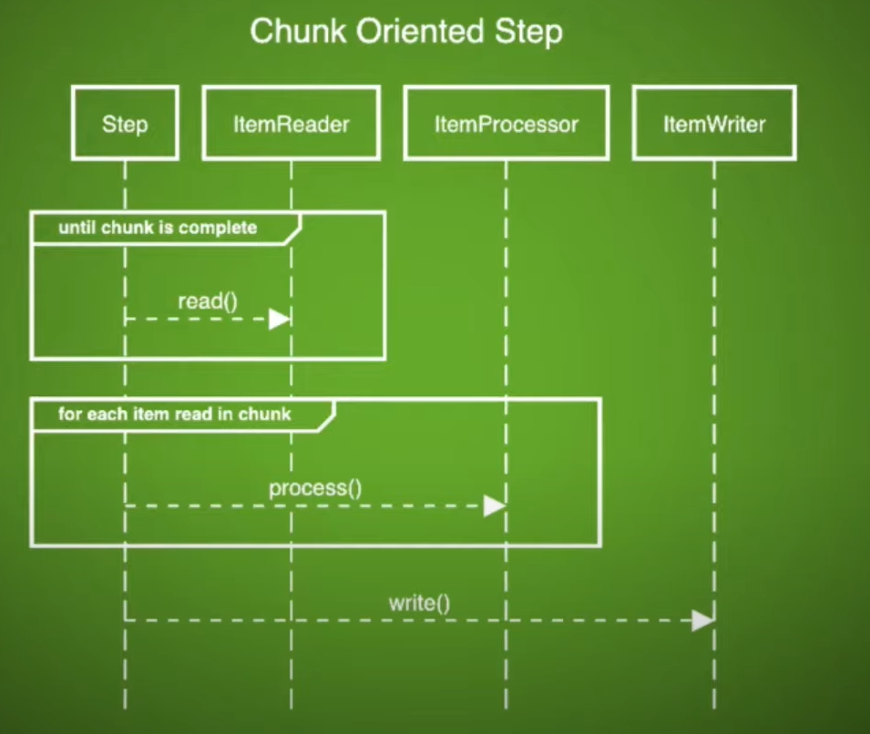
09.

Slide 9
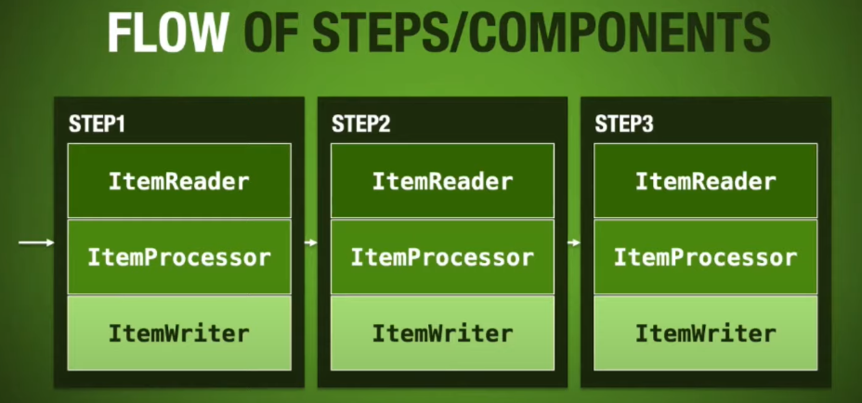
09.

Slide 10
3. Parallel Processing
When you are ready to start implementing a job with some parallel processing, Spring Batch offers a range of options, which are described in this chapter, although some features are covered elsewhere. At a high level, there are two modes of parallel processing
Single process
Multiple process
Multi-threaded Step
Parallel Step
Partitioning
Remote Chunking
11.

Slide 11
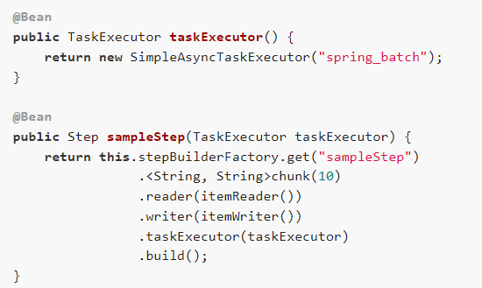
3.1. Multi-threaded Step
The simplest way to start parallel processing is to add a TaskExecutor to your Step configuration.
The taskExecutor is a reference to another bean definition that implements the TaskExecutor interface. TaskExecutor is a standard Spring interface, so consult the Spring User Guide for details of available implementations. The simplest multi-threaded TaskExecutor is a SimpleAsyncTaskExecutor.
The Step executes by reading, processing, and writing each chunk of items (each commit interval) in a separate thread of execution
11.

Slide 12
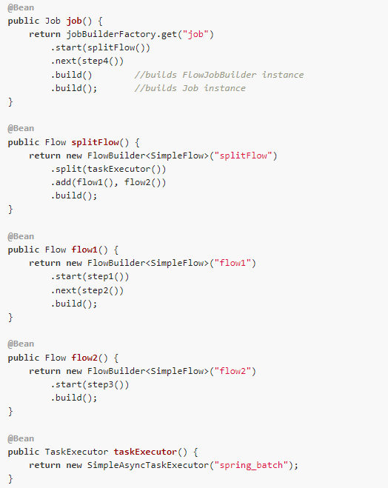
3.2. Parallel Steps
As long as the application logic that needs to be parallelized can be split into distinct responsibilities and assigned to individual steps, then it can be parallelized in a single process.
The default implementation of TaskExecutor is SyncTaskExecutor, but an asynchronous TaskExecutor is required to run the steps in parallel.
So that, SimpleAsyncTaskExecutor is used
11.

Slide 13
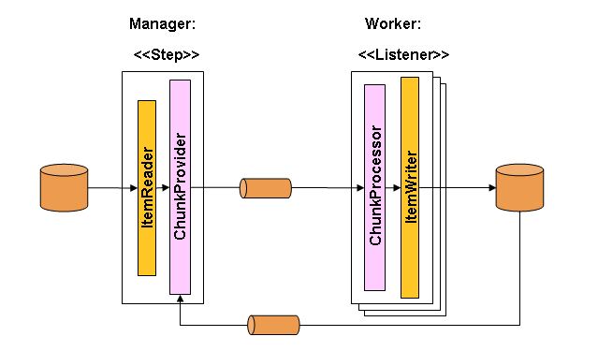
3.3. Remote Chunking
In remote chunking, the Step processing is split across multiple processes, communicating with each other through some middleware. The following image shows the pattern:
The manager component is a single process, and the workers are multiple remote processes. This pattern works best if the manager is not a bottleneck, so the processing must be more expensive than the reading of items (as is often the case in practice).
11.

Slide 14
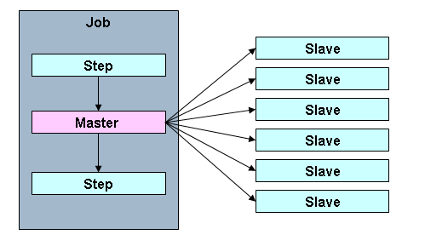
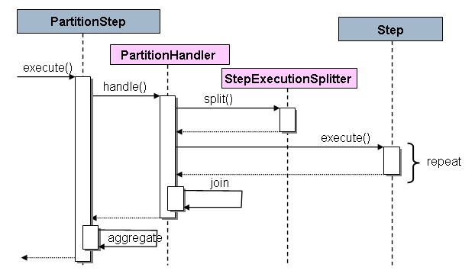
3.4. Partitioning
Spring Batch with partitioning provides us the facility to divide the execution of a Step
There's a Step called “Master”, whose execution is divided into some “Slave” steps. These slaves can take the place of a master, and the outcome will still be unchanged. Both master and slave are instances of Step. Slaves can be remote services or just locally executing threads.
As shown, the PartitionStep is driving the execution. The PartitionHandler is responsible for splitting the work of “Master” into the “Slaves”. The rightmost Step is the slave.
11.

Slide 15

2. Demo
Introduction
We are getting inside a basic project that can handle product order requests from the customers by kafka. Then spring batch will read data from kafka topic and save it to the database
Flow
Request
Spring Batch
Kafka
MySQL
11.

Slide 16
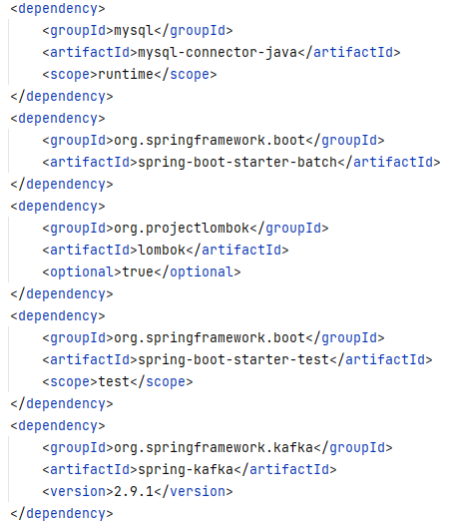
2.1 Config Maven
MySQL connector
Spring batch
Spring kafka
Lombok
11.

Slide 17
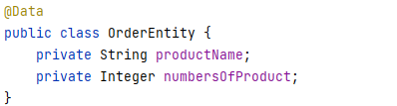
2.2 Entity
productName
numbersOfProduct
11.

Slide 18
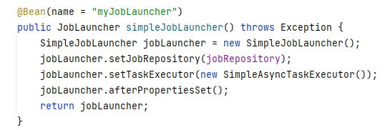
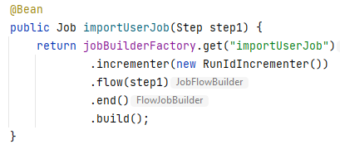
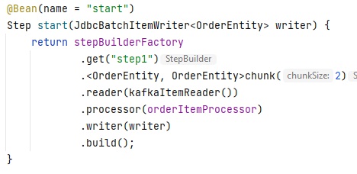
2.3 BatchConfig
JobLauncher
Job
Step
11.

Slide 19
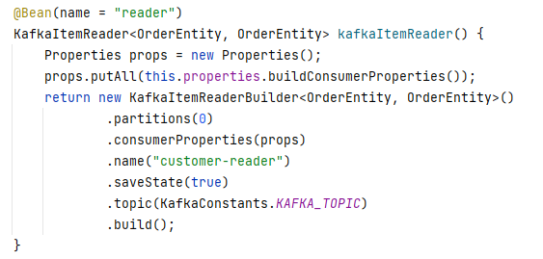
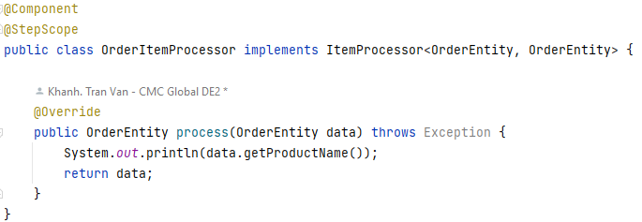
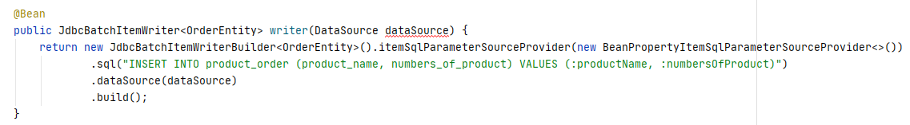
2.3 BatchConfig
ItemReader
ItemProcessor
ItemWriter
11.

Slide 20
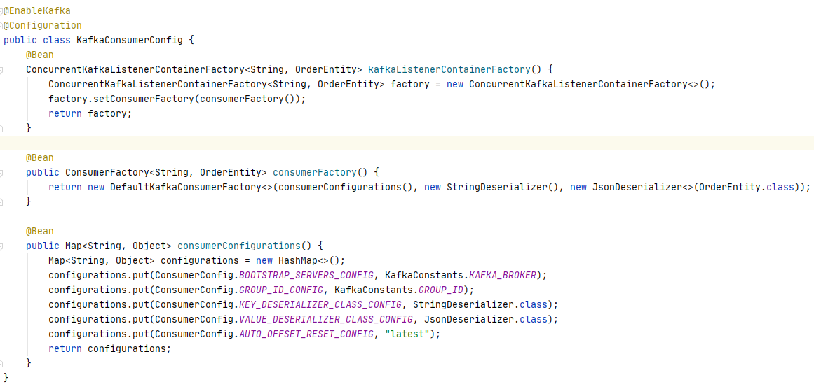
2.4 Kafka config
KafkaConsumerConfig
11.

Slide 21
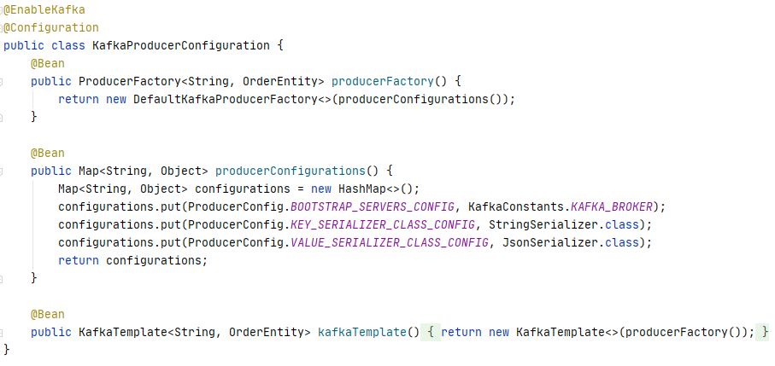
2.4 Kafka config
KafkaProducerConfig
11.

Slide 22
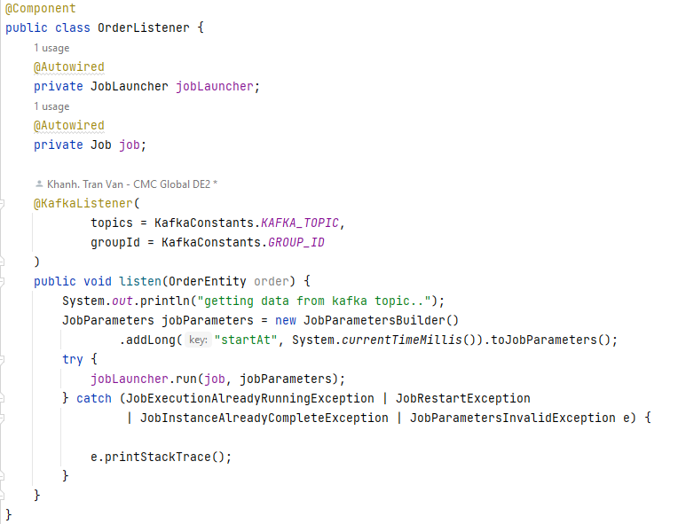
2.5 KafkaListener
Create a Kafka listener to listen to kafka topic.
Whenever kafka topic receiving new data, the kafka listener will be notified.
So that, if listener gets new data from kafka topic, it will run jobLauncher in order to start the spring batch
11.

Slide 23
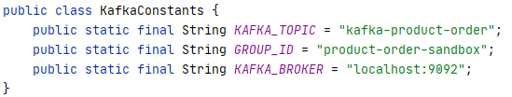
2.6 KafkaConstants
Set kafka topic name, group id and kafka broker
11.

Slide 24
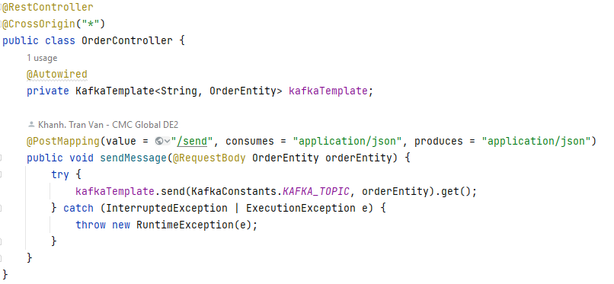
2.7 Rest Controller
Rest controller is responsible for handling request via api url.
Whenever new request comes, the controller will get data and send it directly to kafka topic.
11.

Slide 25
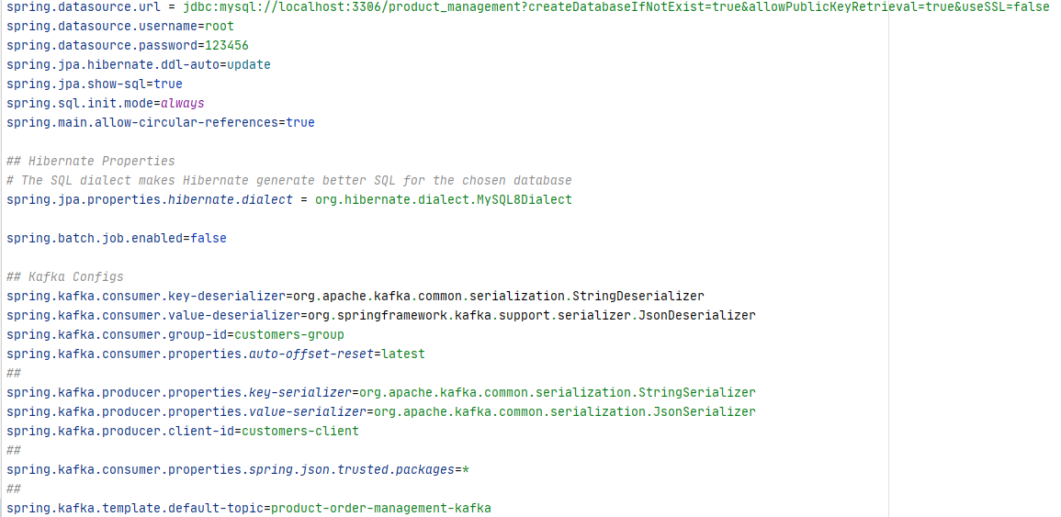
2.8 Application.properties
Config mysql, kafka and spring batch
11.

Slide 26
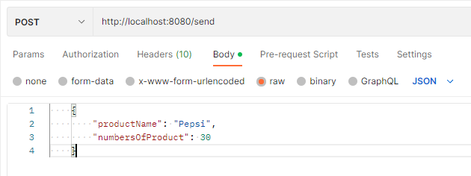
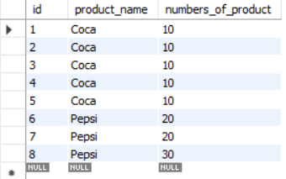
2.9 Run Application
Run Zookeeper and Kafka server first
Run Spring boot project
Send request to api url
Check the result
It works. Happy ending!!
11.

Slide 27
2.9 Run Application
Run Zookeeper and Kafka server first
Run Spring boot project
Send request to api url
Check the result
It works. Happy ending!!
11.

Slide 28
4.0 Reference
11.

Slide 29

CMC GLOBAL
java
THANK YOU
If you have any questions at all
Don't hesitate to ask.
tvkhanh1@cmcglobal.vn
14.

